Slide 1
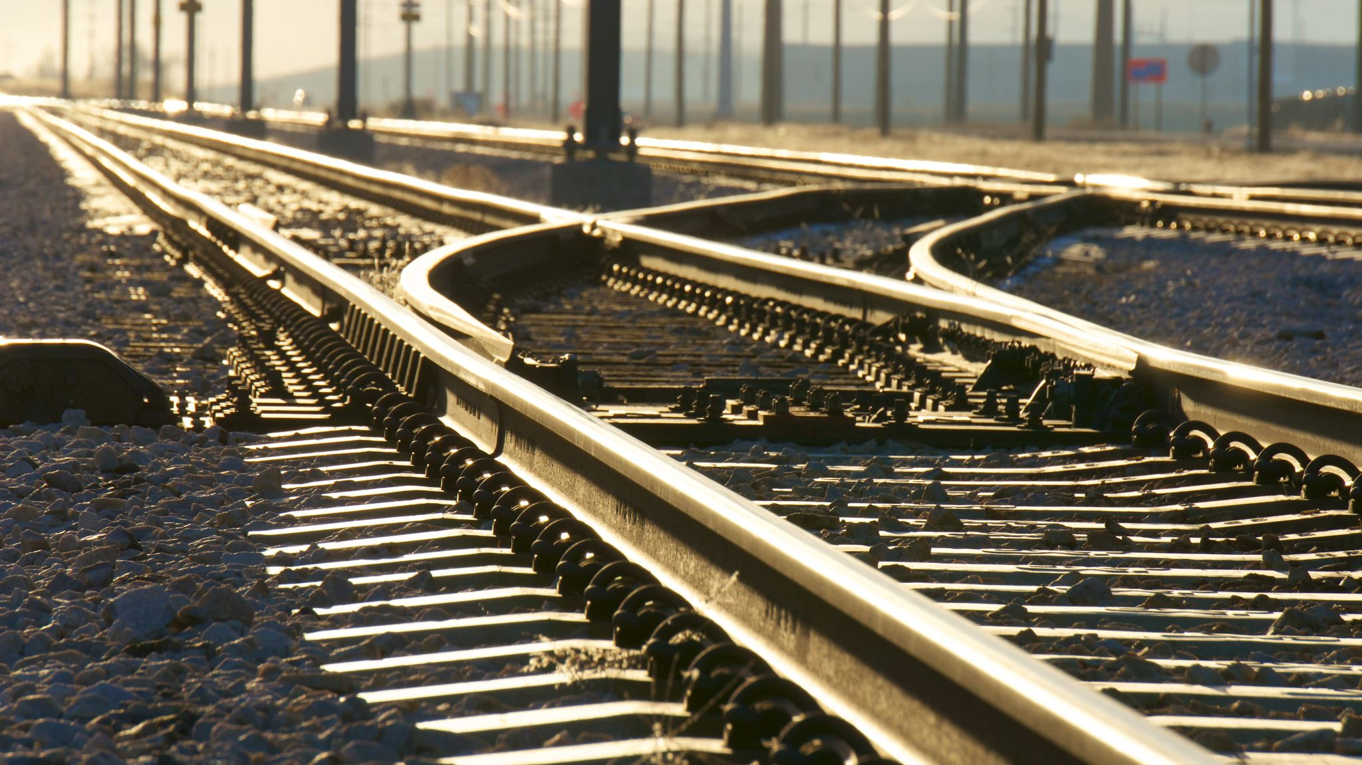
Virgin Rail Trains
By: Sajal Gokani
ID: 476587

Slide 2
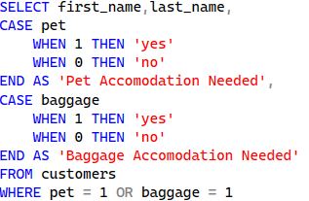
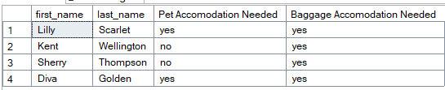
1. Get a list of customers that require pet or baggage accommodations.

Slide 3

2. What is the most popular seating accommodations on the train?

Slide 4
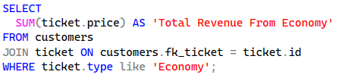

3. What is the total revenue from the customers who booked economy seating?

Slide 5
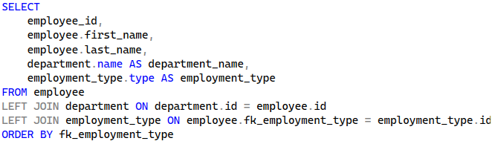
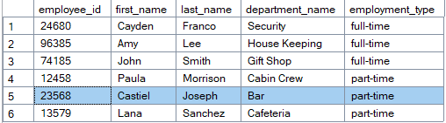
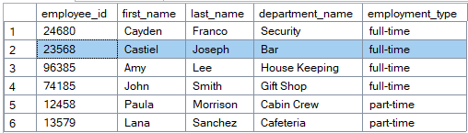
4. The train now offers longer service hours at the bar. Update Castiel (employee_id: 23568) to a full-time employee.

Slide 6
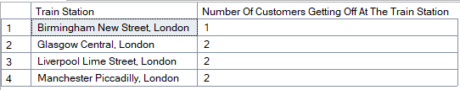
5. How many customers are getting off at each station?

